Slide 1
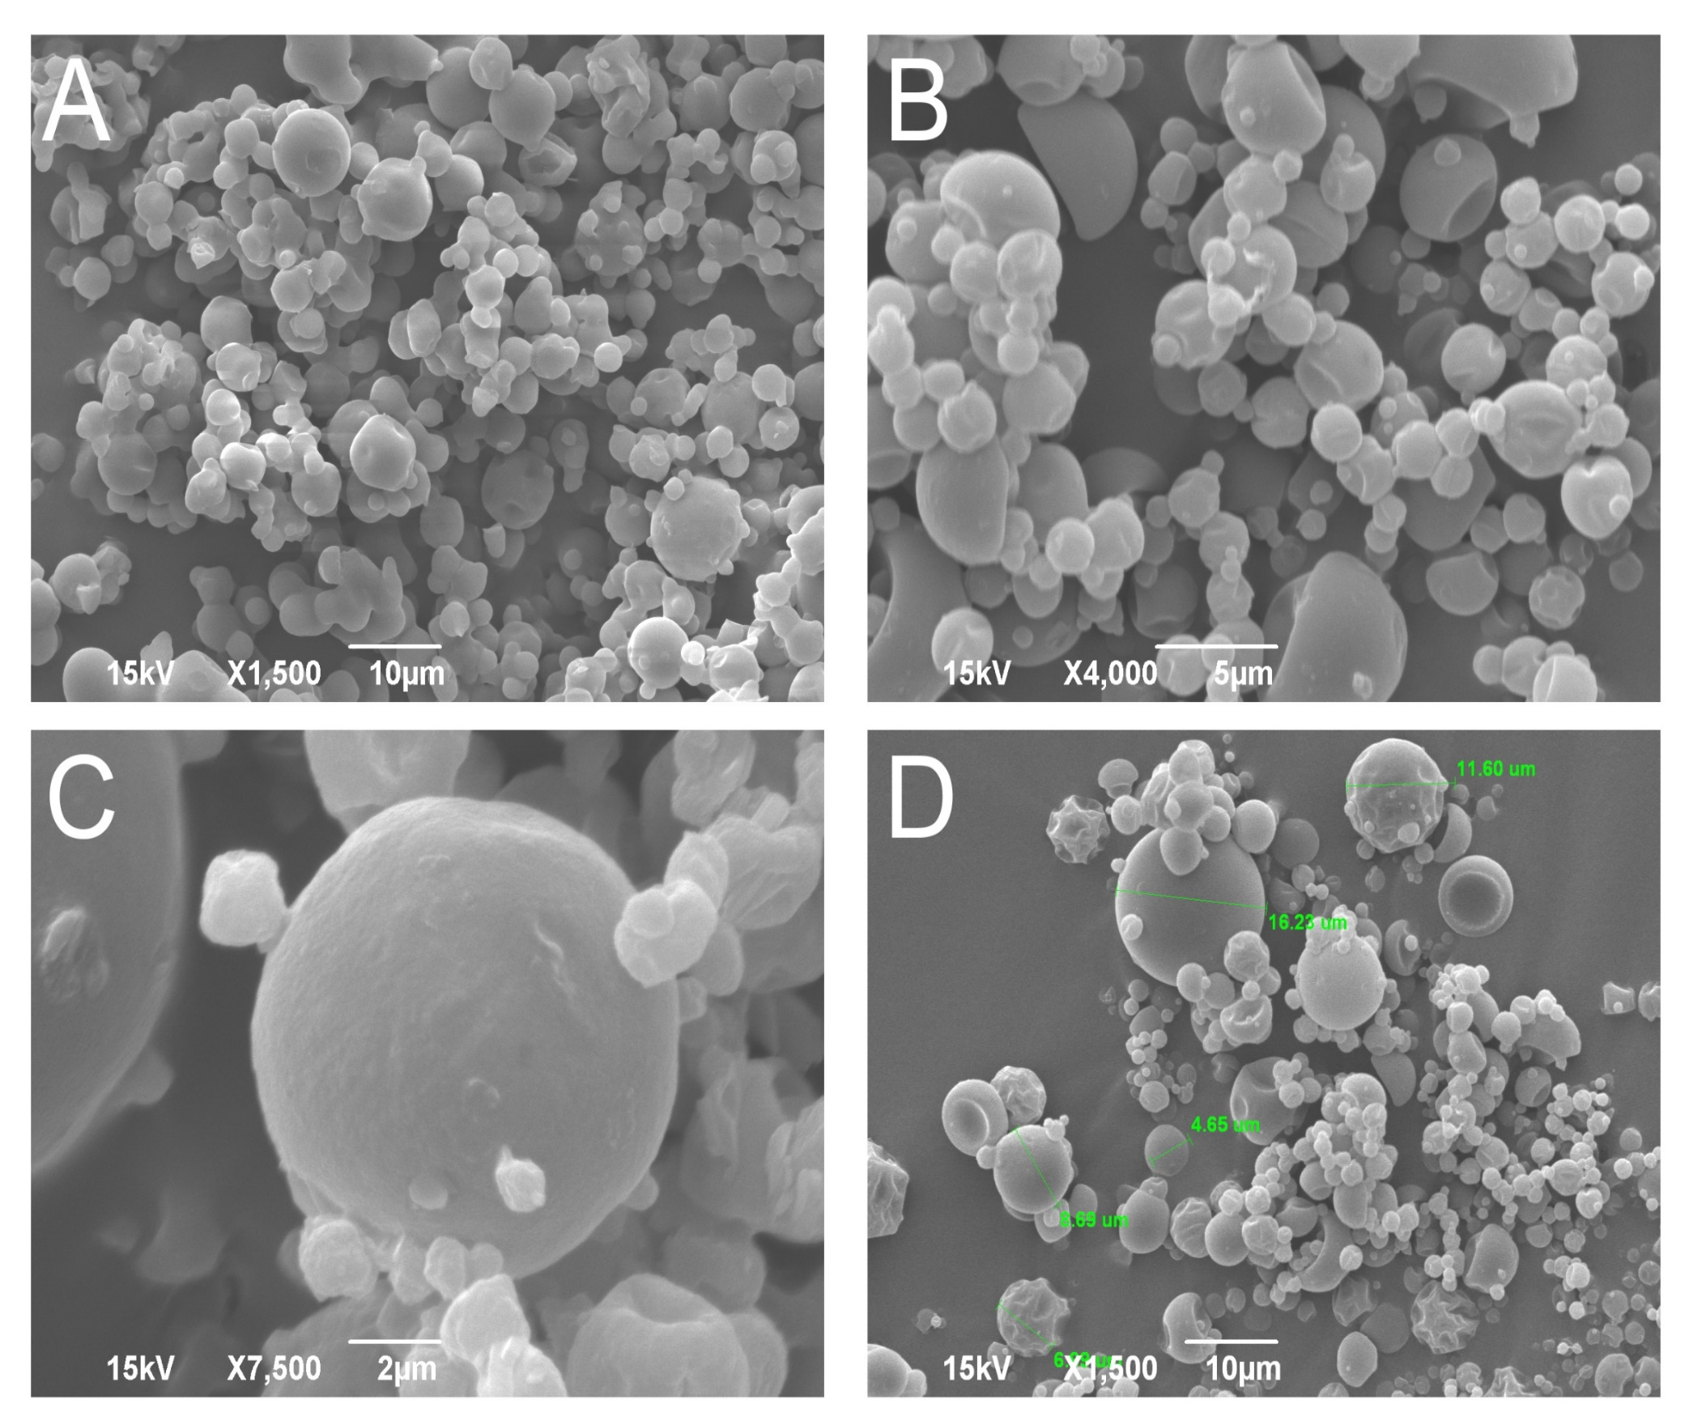
Pectin as a carrier of chokeberry polyphenols:
ingredients for potenthial health benefit
Nada Ćujić Nikolić¹, Predrag Petrović², Katarina Šavikin¹, Teodora Janković¹
¹Institute for Medicinal Plants Research,Tadeuša Košćuška 1, 11000 Belgrade, Serbia
²Faculty of Technology and Metallurgy, Department of Chemical Engineering, University of Belgrade, Karnegijeva 4, 11000 Belgrade, Serbia
Introduction
Chokeberry, one of the richest phenolics source, especially anthocyanins, represent a natural nutraceutical, due to its high antioxidant potential. Chokeberry juice processing generates a waste by-product, rich in polyphenolics, which can be extracted. Problem with polyphenols instability could be solved by spray drying, a microencapsulation technique for controlled production of small particles simultaneously increasing polyphenols bioavailability and stability.
Results
Microencapsulation
Result showed that stability of polyphenols, especially anthocyanins could be improved using the spray drying. Obtained microparticles sizes were 7.36 and 11.65 µm, moisture content 4.84 and 5.32 %, for PCE and PCWE, respectively. SEM analysis showed that pectin provided less aggregated particles with expressed spherical shapes. FTIR showed several relevant picks, which indicate that extracts were successfully incorporated into biopolymer matrix. ZP was –38.52 and -39.94 mV, for PCE and PCWE, indicating favourable physical properties of particles. The amounts of TP (23.33 mg GAE/g for PCE, 35.90 mg GAE/g for PCWE) and TA (8.91 mg CyG/g for PCE, 12.85 mg CyG/g for PCWE) released from microencapsulated powders before, as well after digestion process (14.15 mg GAE/g for PCE, 19.82 mg GAE/g for PCWE) of TP and (6.22 mg CyG/g for PCE, 9.40 mg CyG/g for PCWE) of TA were achieved.
For microencapsulation of chokeberry extract (CE) and chokeberry waste extract (CWE) a pectin (P) (5% w/v) was used as a carrier.
Methods
SEM analysis
Microencapsulated systems, PCE and PCWE were examined (FTIR, SEM, particle size, zeta potential (ZP) and moisture content). In vitro simulated digestion method was used in order to determine changes in polyphenols content in gastrointestinal environment. The release profiles from microparticles were investigated by determining the total phenolic (TP) and total anthocyanins (TA) content, as well as individual phenolics using HPLC method.
FTIR analysis
Conclusion
Microencapsulated pectin showed significant effect on the polyphenols degradation during digestion process, having the protective effect.
UNIFood Conference September 24th-25th 2021 University of Belgrade
HPLC analysis

